Slide 1
Defining features of linear relationships
Task A: Numerical features of linear relationships
1) These are tables of values for linear relationships. Fill in the missing values and complete the statements about the rate of change.
a)
x | −2 | −1 | 0 | 1 | 2 | 3 | 4
y |  |  | 2 | 7
For every change of +1 in x there is a change of __ in y
b)
x | −2 | −1 | 0 | 1 | 2 | 3 | 4
y |  |  | −4 |  | 10
For every change of +1 in x there is a change of __ in y
c)
x | −2 | −1 | 0 | 1 | 2 | 3 | 4
y |  |  | 2 |  |  |  | 8
For every change of +1 in x there is a change of __ in y
d)
x | −2 | −1 | 0 | 1 | 2 | 3 | 4
y |  |  | 12 |  |  | −3
For every change of +1 in x there is a change of __ in y

Slide 2
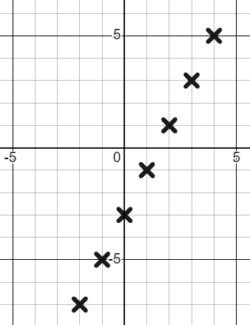
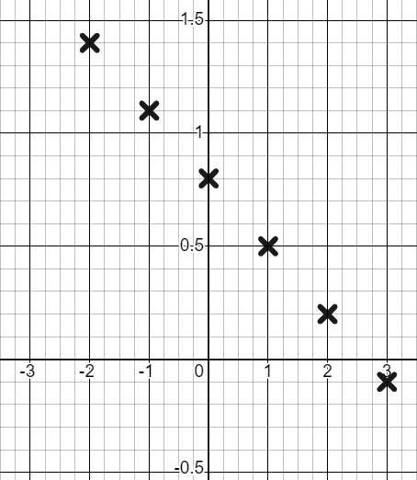
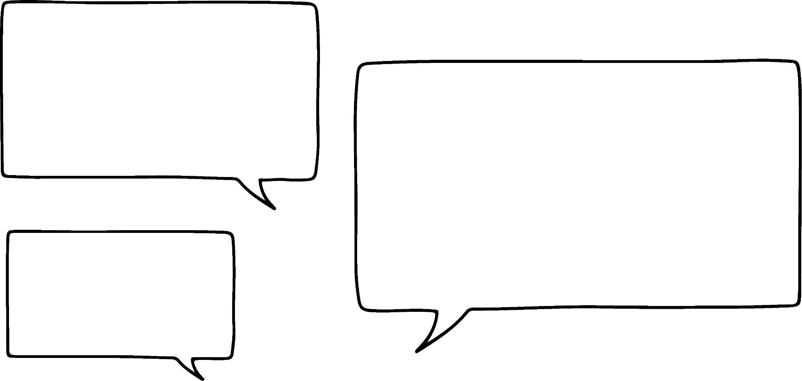

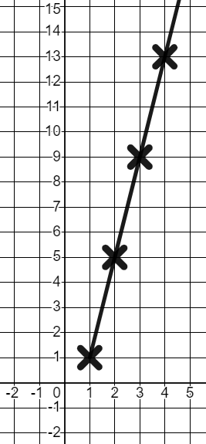
Defining features of linear relationships
2) Use the graph to complete the table and write a sentence about the rate of change.
a)
y
x | −2 | −1 | 0 | 1 | 2 | 3 | 4
y
x | −2 | −1 | 0 | 1 | 2 | 3 | 4
y
x
b)
y
x | −2 | −1 | 0 | 1 | 2 | 3
y
x | −2 | −1 | 0 | 1 | 2 | 3
y
x
Task B: Graphical features of linear relationships
1) Izzy has completed a table of values and plotted coordinates for the linear relationship y = 4x − 3
x | 1 | 2 | 3 | 4
y | 1 | 5 | 9 | 13
The line y = 4x − 3 starts at 1 and has a rate of change of +4 each time.
y
x

Slide 3
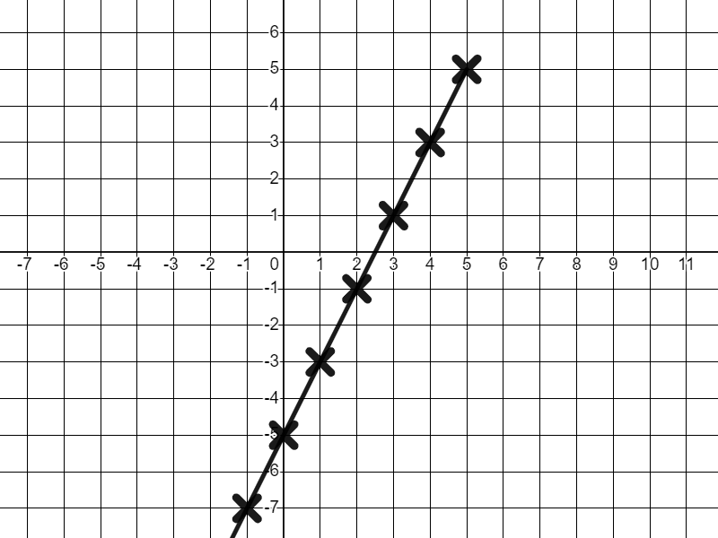
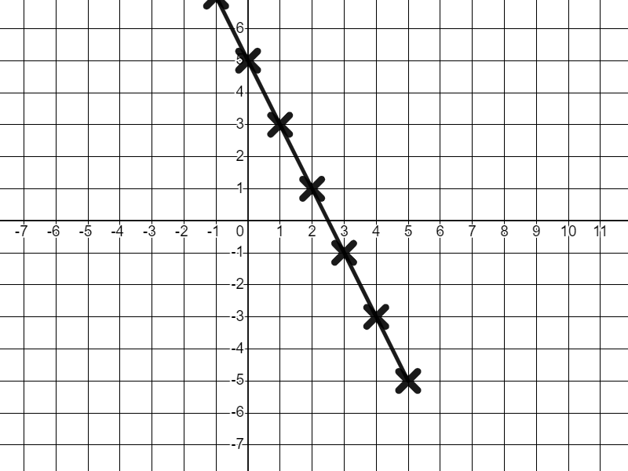
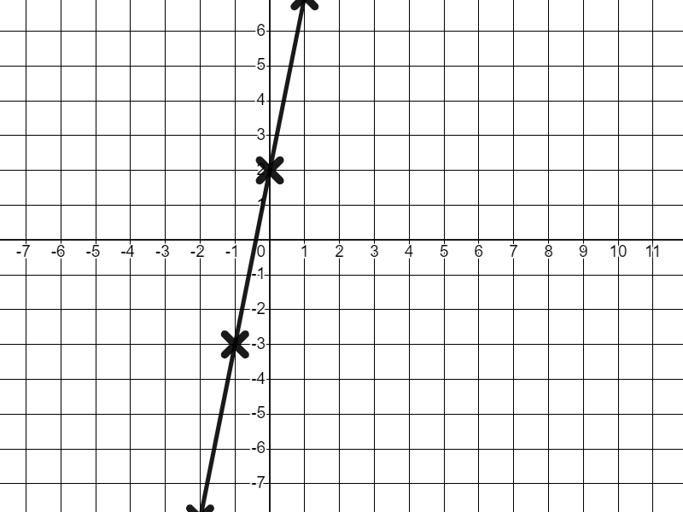
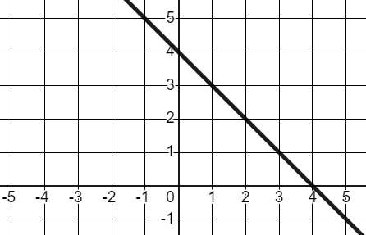
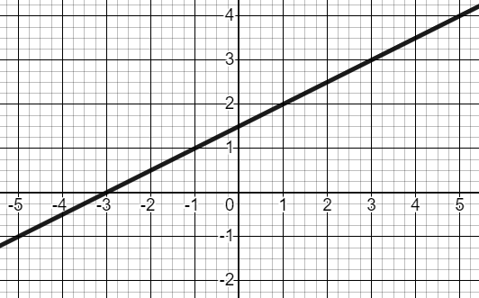
Defining features of linear relationships
2) Match the graphs to their unique descriptions.
Intercepts the y-axis at (0, 5), rate of change of −2
Intercepts the y-axis at (0, 2), rate of change of +5
Intercepts the y-axis at (0, −5), rate of change of +2
3) Write unique descriptions for these two graphs. Be sure to include the words y-intercept and rate of change..
a)
b)
Mathematics in Education and Industry
v2.2

